Slide 1
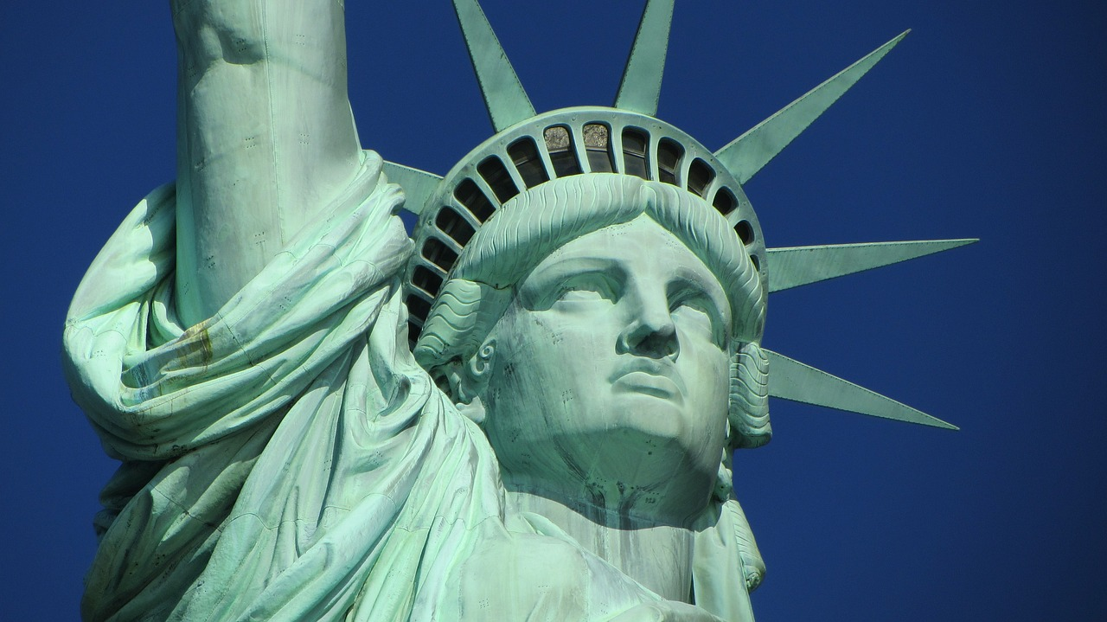

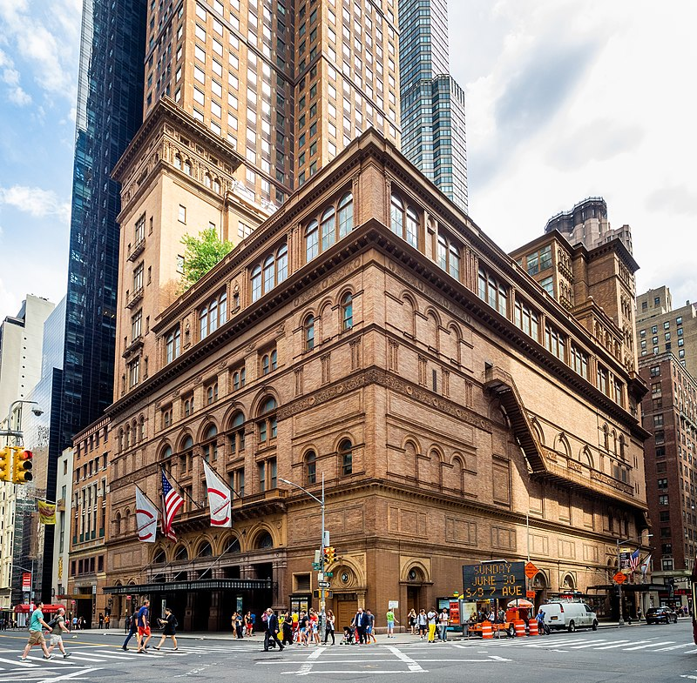
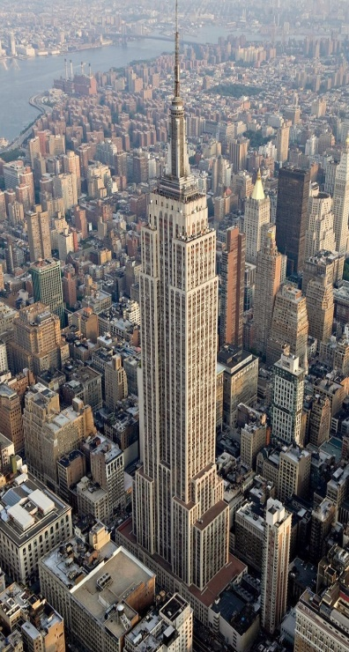
Historical Landmarks & Airbnb Listings in new York city
Alyshia Kiczma
Arshdeep Khurana
Nasir Qadri
Kaylyn Valdez-Scott

Slide 2
Project description
We are a group hired by Airbnb, tasked with creating a dashboard of visualizations showing the locations of Airbnbs listed and the locations of historical landmarks in an interactive map format using latitudes and longitutes, with popups for prices of Airbnbs and descriptions of the Historical Landmarks

Slide 3
Questions of Interest
What are the major landmarks surrounding boroughs in New York City? Can you provide some info about each landmark?
Where can consumers stay when on a trip to New York City? What neighborhood and borough are they located in?
What are the prices of these locations to stay?

Slide 4
ETL

Slide 5
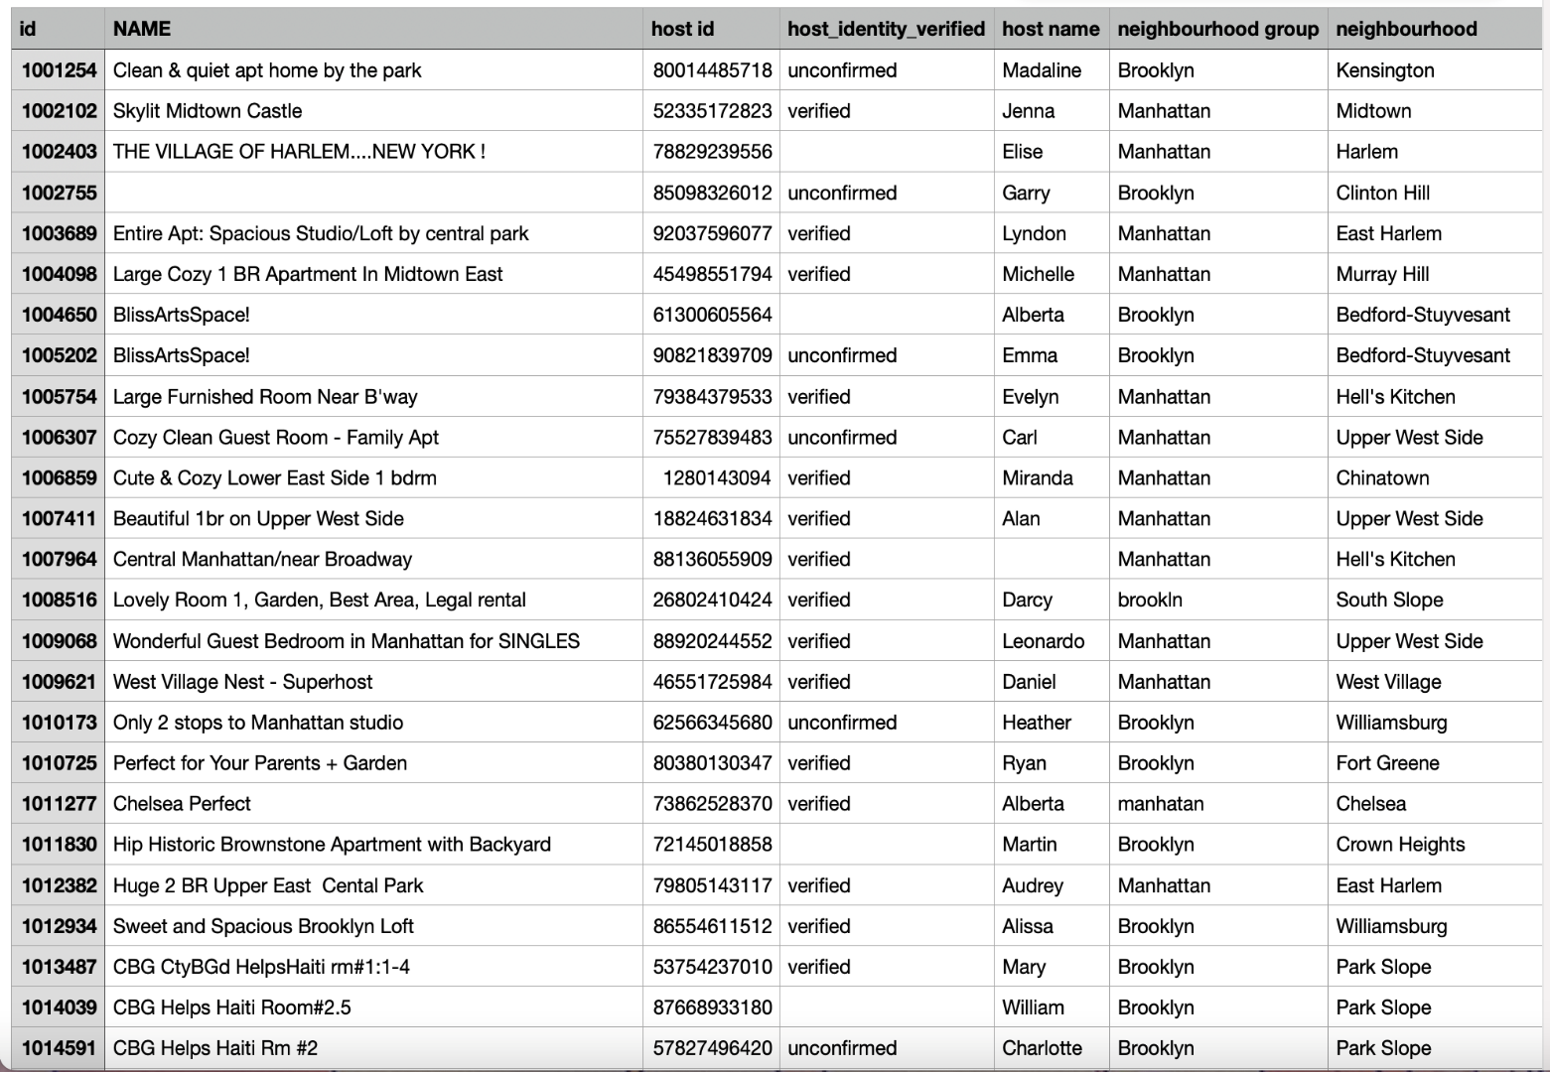
Data set (used in project 1)
https://www.kaggle.com/datasets/arianazmoudeh/airbnbopendata?select=Airbnb_Open_Data.csv

Slide 6
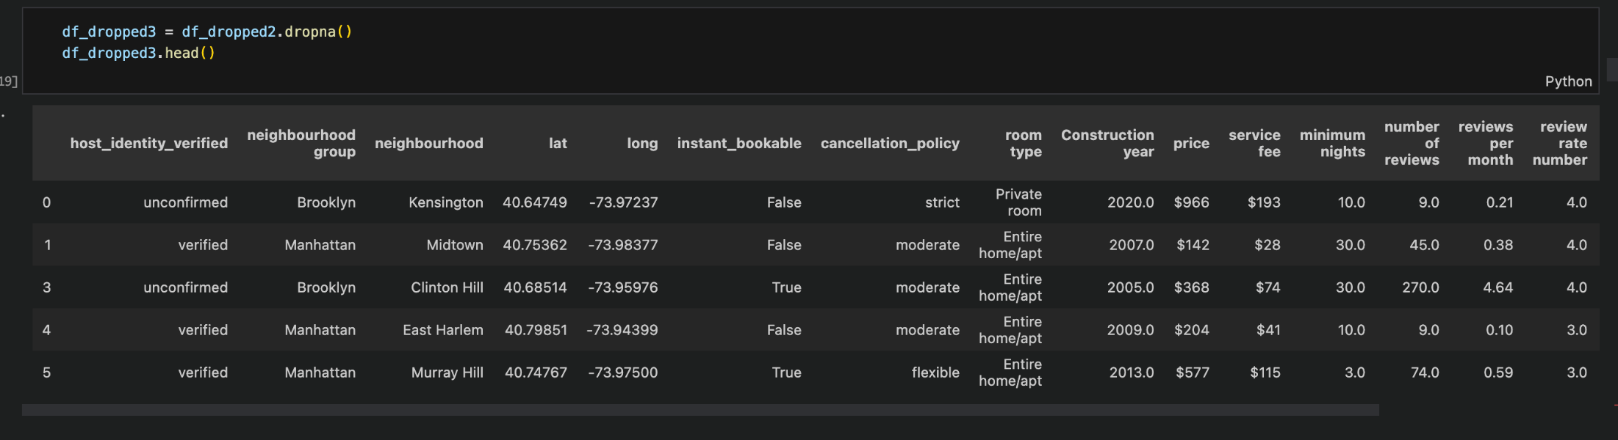

Slide 7
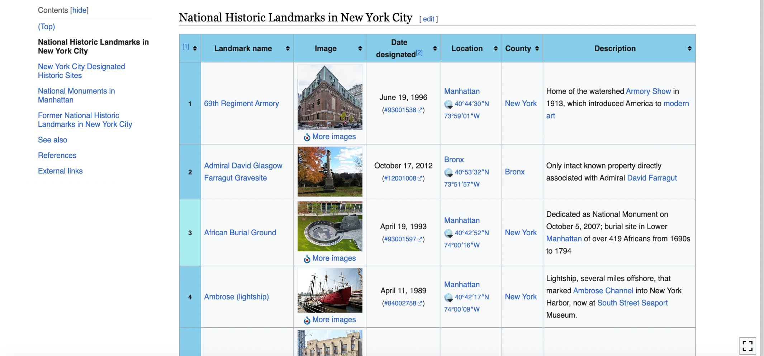
Web Scraping from Wikipedia

Slide 8
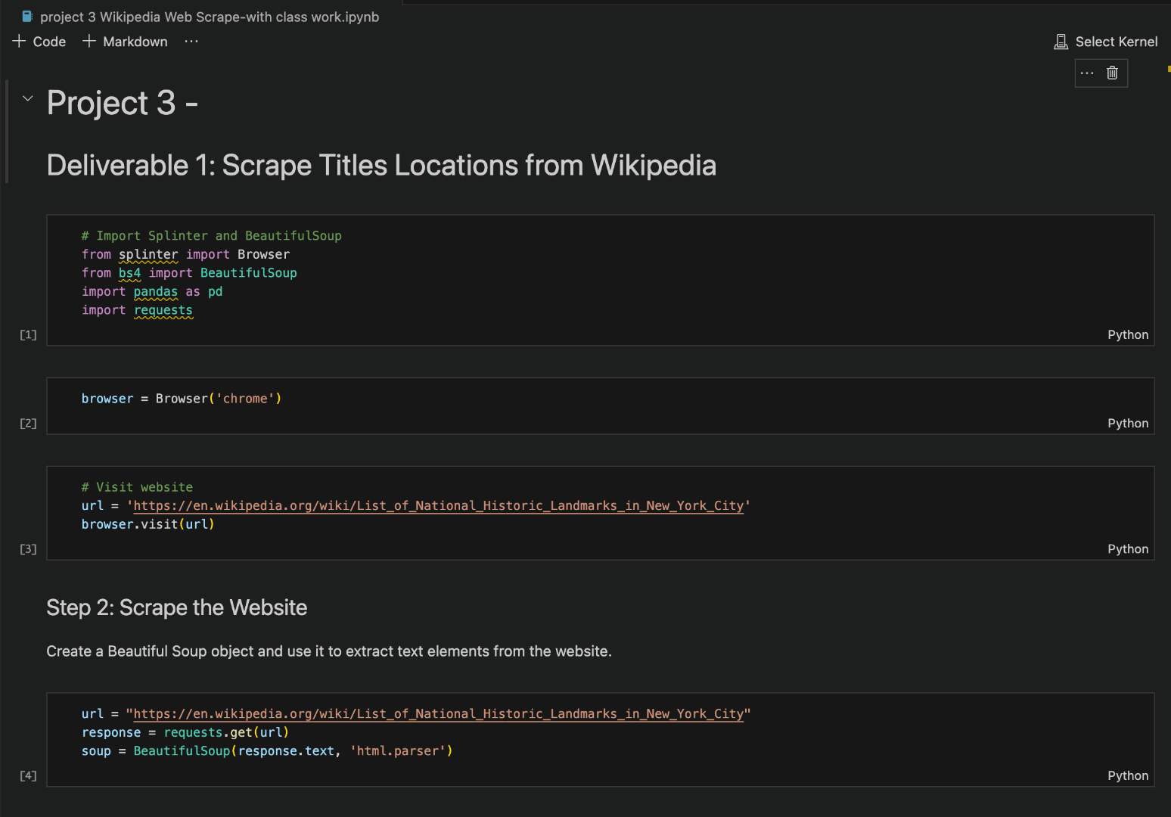
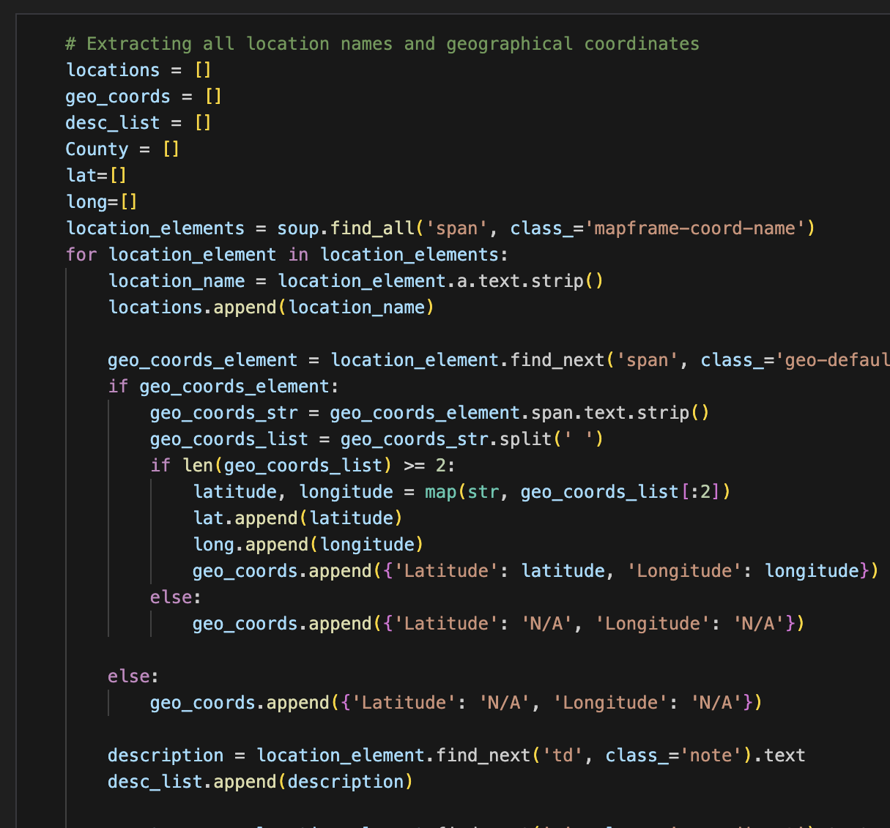

Slide 9
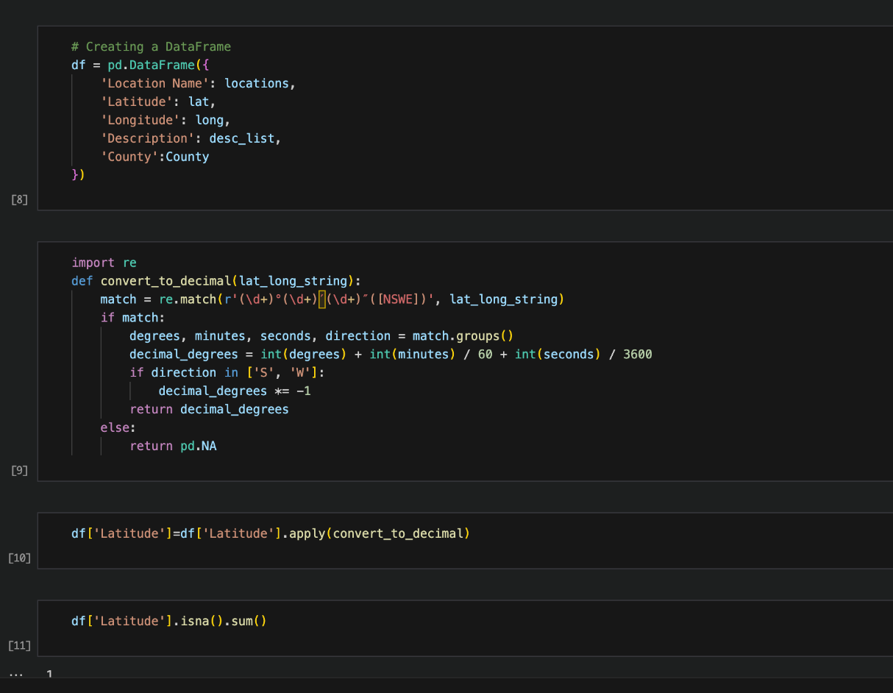
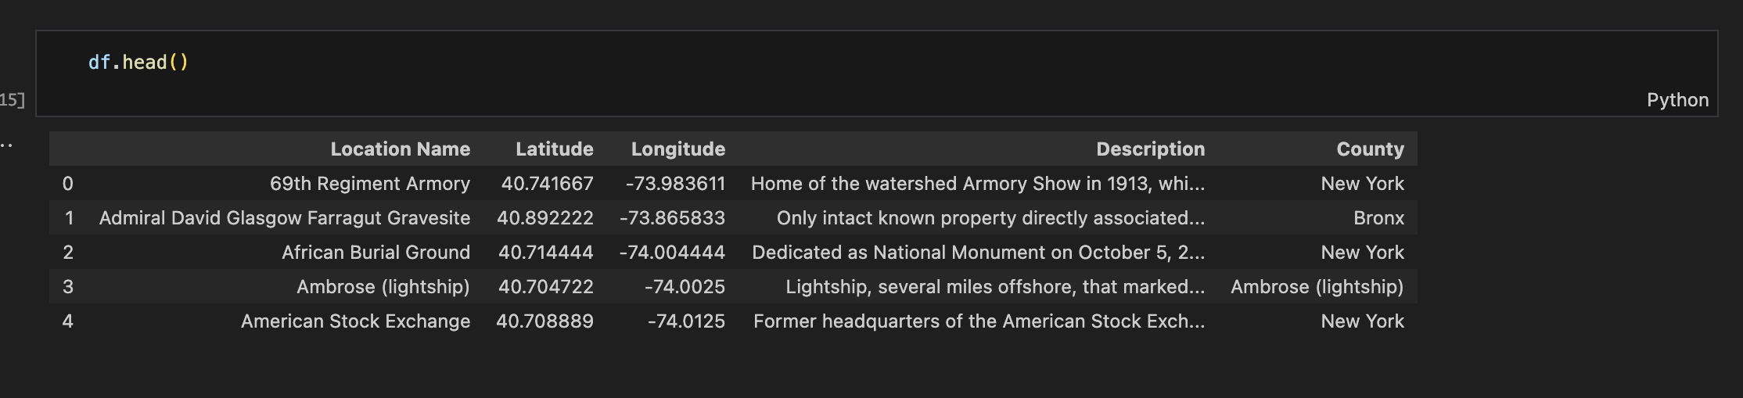
New dataframe

Slide 10
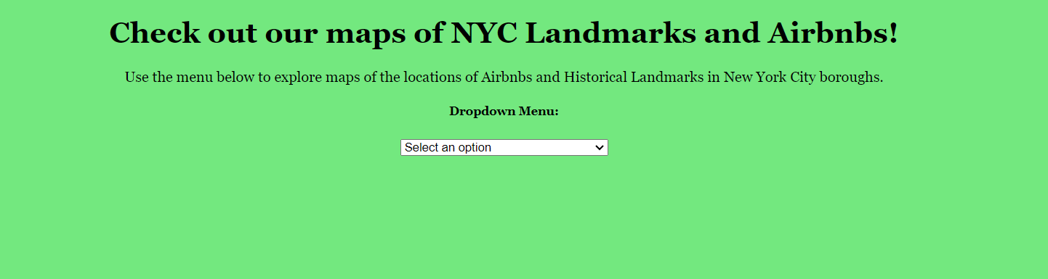
Dashboard

Slide 11
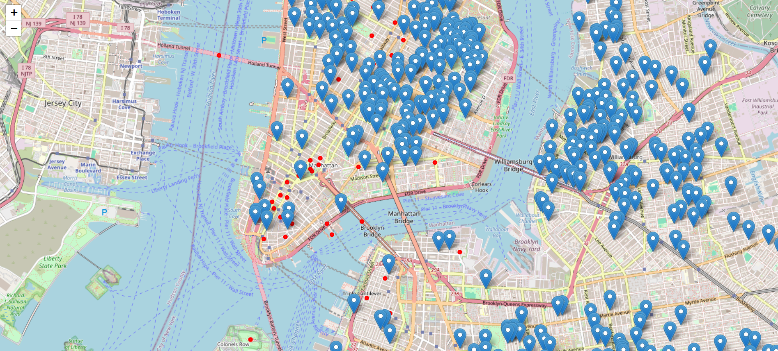
map of nyc landmarks

Slide 12
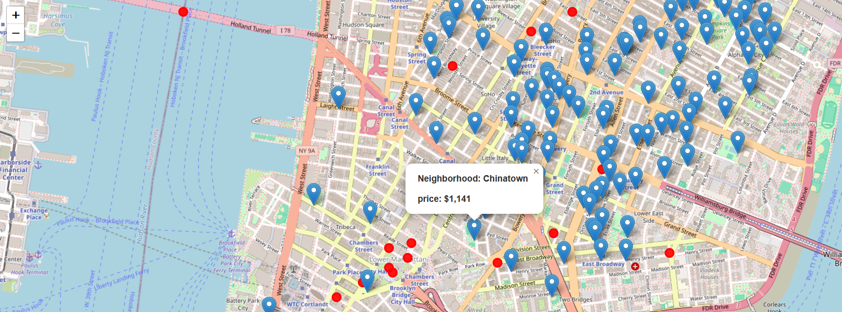
map of Airbnb rental locations

Slide 13
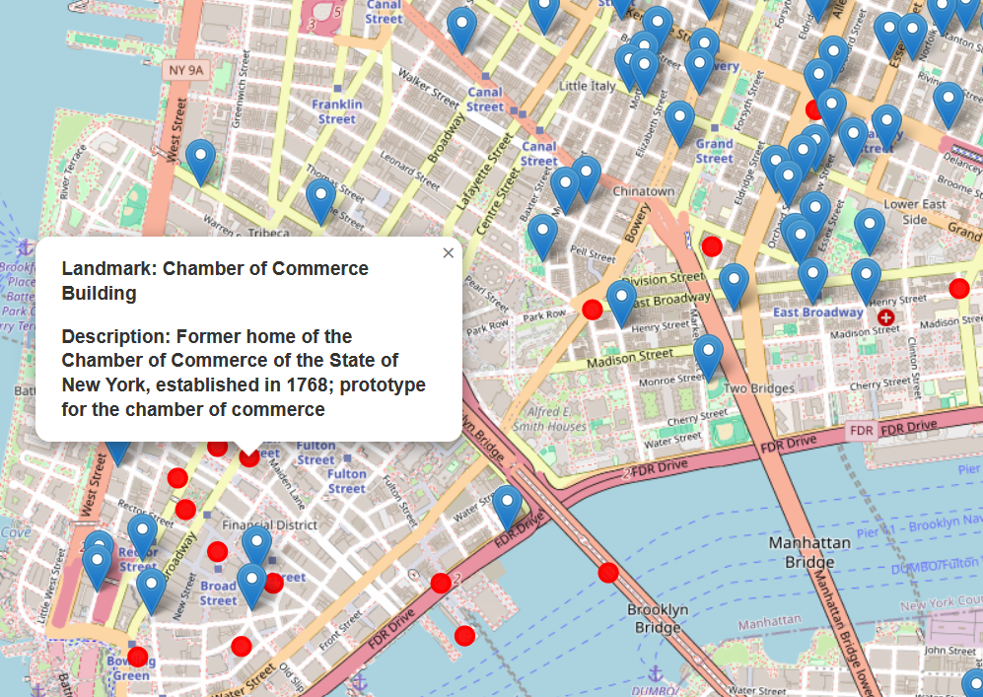
map of nyc landmarks

Slide 14
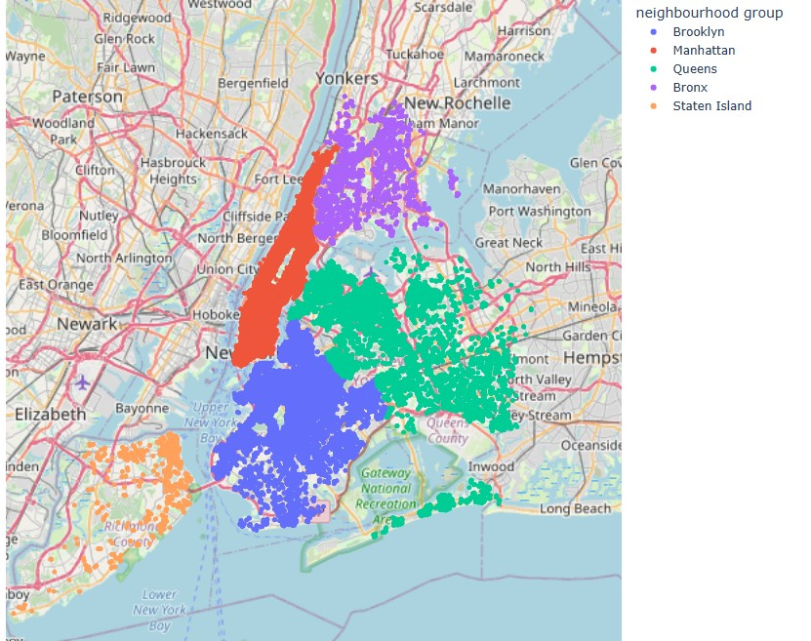
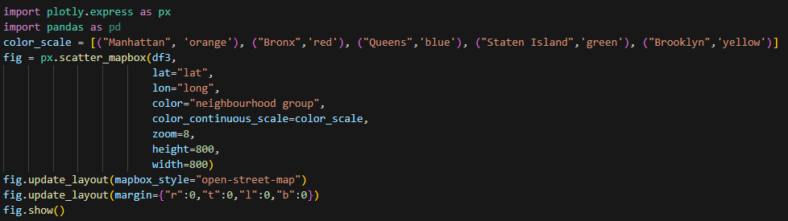
Airbnb listings by neighbourhood

Slide 15
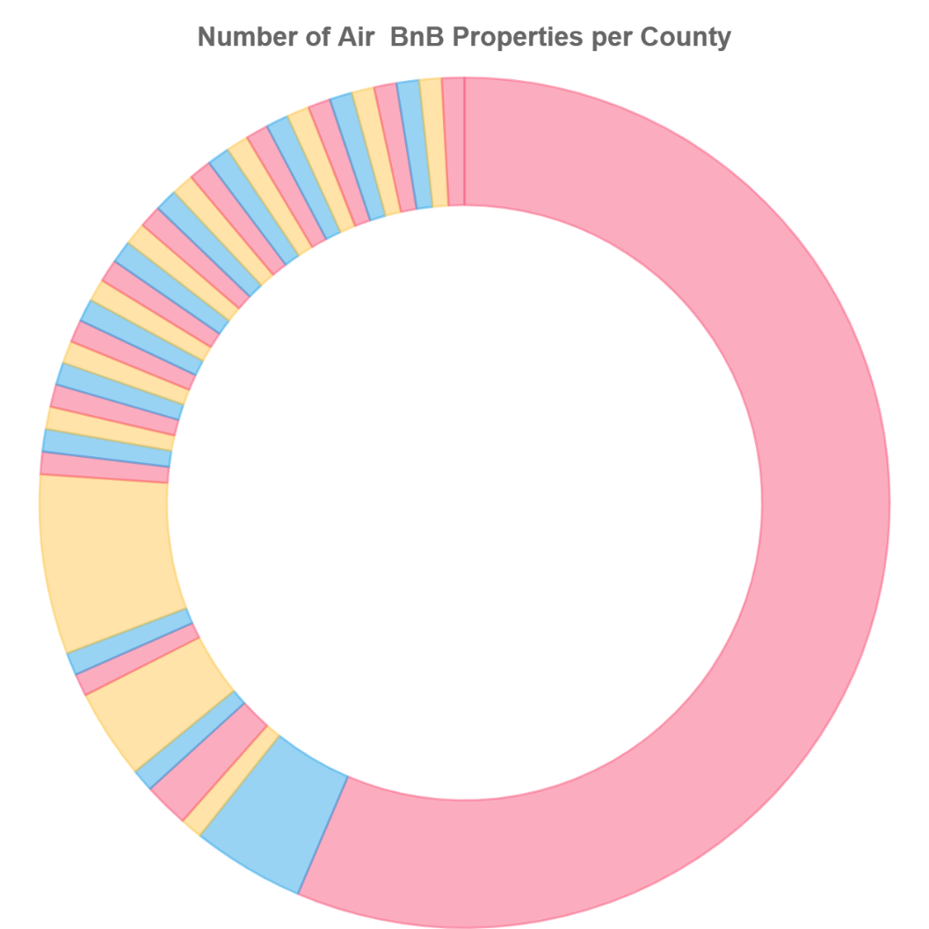
visualizations

Slide 16
futher explorations
How can we go deeper into this visualization project?
Pricing – Price of Airbnbs in each neighbourhood, county and borough
Interactivity – Clicking on a landmark to bring up nearby Airbnb locations – making the map more interactive
More relevant travel information – such as restaurants, transit and events in each neighbourhood, borough or county

Slide 17
Thank you for listening!

